Slide 1
CSS
Cascading Style Sheets

Slide 2
Recap:
Quick Quiz
Notes:
What does HTML stand for?
What does it do?
How do we add style to HTML?
How far have we got through freeCodeCamp?
What other learning platforms are people using?

Slide 3

Question 1
Which tag is used to create a link to another page?
<p>
<link>
<a>
<ol>

Slide 4
Question 1
Which tag is used to create a link to another page?
<p>
<link>
<a>
<ol>

Slide 5
Question 2
What are the two tags that nest directly within the <html> tags?

Slide 6
Question 2
What are the two tags that nest directly within the <html> tags?
<head> and <body>

Slide 7
Question 3
What is it called when you have a 'tag' + 'content' + 'closing tag'?

Slide 8
Question 3
What is it called when you have a 'tag' + 'content' + 'closing tag'?
An HTML Element

Slide 9
RECAP: Anatomy of a website
Your Content
Plus HTML for structure
Plus CSS for presentation
Equals
YOUR WEBSITE
We use HTML and CSS to give form and style to the content

Slide 10
CSS: What is it?
CSS = Cascading Style Sheets
CSS is a "style sheet language" that lets you style the elements on your page.
CSS is works in conjunction with HTML, but is not HTML itself.

Slide 11


CSS - What can it do?

Slide 12
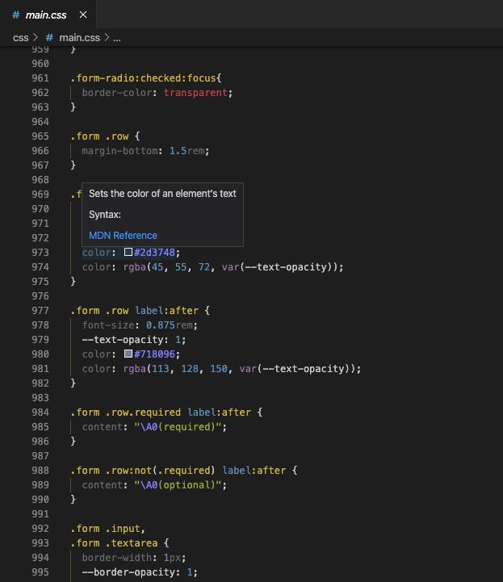
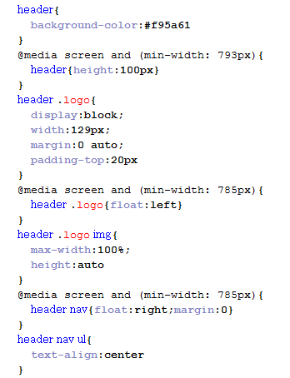
CSS - What does it look like?

Slide 13
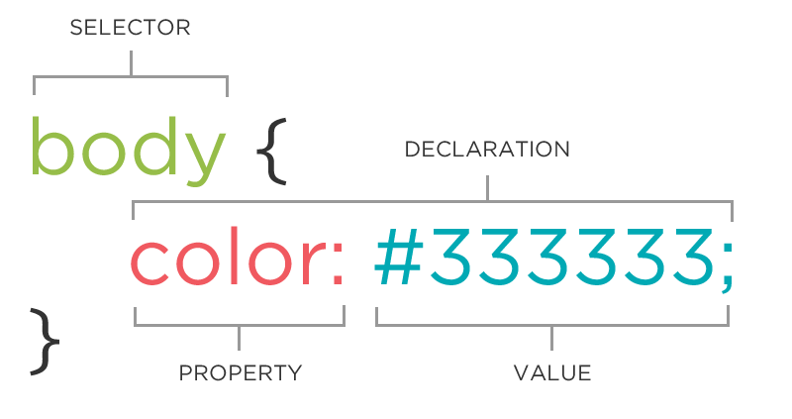
The CSS Rule

Slide 14
The CSS Rule
A block of CSS code is a rule.
The rule starts with a selector.
It has sets of properties and values.
A property-value pair is a declaration.
selector {
property: value;
}

Slide 15
Connecting CSS to HTML
3 ways
"Inline"
"Embedded"
"External"

Slide 16
Connecting CSS to HTML: Inline
Uses the HTML attribute style.
Difficult to use in large projects
Not preferred.
<p style="color:red">Some text.</p>

Slide 17
Connecting CSS to HTML: Embedded
Inside <head> element.
Uses <style> tag.
Can only be used in one html file
<head>
<style type="text/css">
p {
color: blue;
font-size: 12px;
}
</style>
</head>

Slide 18
Connecting CSS to HTML: Linked
Shared resource for several pages.
Reduced file size & bandwidth
Easy to maintain in larger projects.
Preferred by nerds everywhere!
<head>
<link rel="stylesheet" type="text/css" href="style.css">
</head>

Slide 19

Task 2.2.1
Student:
Create Task-2.2.1.html
Set up with a doctype, head, title and body.
Together :
Connect a stylesheet to our HTML document
Student:
Add the CSS rule to the left to the CSS file:
Together :
Commit the change
Push to remote
Assisted Task

Slide 20
CSS Syntax
Declarations: Property and value of style you plan to use on HTML element.
Declarations end with a semicolon
Declaration groups are surrounded by curly brackets.
selector {
property: value;
property: value;
property: value;
}

Slide 21
Selector: Element
img {
property: value;
}
Selects all image elements.
p {
property: value;
}
Selects all paragraph elements.

Slide 22
CSS Colour Values
Your browser can accept colors in many different ways:
Color name (ex. red)
Hexadecimal value (ex. #FF0000)
RGB value (ex. rgb(255, 0, 0))
HSL value (ex. hsl(0, 100%, 100%))
The 17 standard colors are: aqua, black, blue, fuchsia, gray, grey, green, lime, maroon, navy, olive, purple, red, silver, teal, white, and yellow.

Slide 23
Property: Colour
The color property changes the colour of the text.
p {
color: red;
color: #ff0000;
color: rgb(255, 0, 0);
}

Slide 24
Property: Background Colour
The background-color property changes the color of the background.
p {
background-color: black;
background-color: #000000;
background-color: rgb(0,0,0);
}

Slide 25
Task 2.2.2
Student:
Create Task-2.2.2.html
Connect a stylesheet to our HTML document
Student:
Add some rules to your css ‘file’
Change the font color and background color of different types of elements
Try selecting links, paragraphs, and lists
Commit the change
Push to remote

Slide 26
Property Values
Each property can have one or more comma separated values.
p{
color: white;
background-color: red;
font-family: Arial, sans-serif;
}

Slide 27
Property: Font Family
The font-family property defines which font is used.
Specific font name
Generic name
Comma-separated list
p {
font-family: "Times New Roman";
font-family: serif;
font-family: "Arial", sans-serif;
}

Slide 28
Property: Font-size
The font-size property specifies the size of the font.
Pixels
"em"
Percentage
p {
font-size: 12px;
font-size: 1.5em;
font-size: 100%;
}

Slide 29
Property: Fonts Shorthand
p {
font-style: italic;
font-weight: bold;
font-size: 10px;
font-family: sans-serif;
}
p {
font: italic bold 10px sans-serif;
}

Slide 30
Task 2.2.3
Student:
Create Task-2.2.3.html
Connect a stylesheet to our HTML document
Student:
Add some rules to your css ‘file’
Change the fonts of your page
Try changing the font sizes and styles for different elements
Commit the change
Push to remote

Slide 31
Selector: Position
p em {
color: yellow;
}
Selects all em elements that are within a paragraph
<p>This is <em>important.</em></p>
The associated HTML.

Slide 32
Selector: Position
Position selectors are more specific
They look for elements inside other elements
We separate nested elements with a space

Slide 33
Selector: Position
So this code:
ul li a strong{
color: purple;
}
Means "find a strong tag inside a link inside a list item in an unordered list"
<ul>
<li><a href="programs.html">Our <strong>program</strong></a> </li>
</ul>

Slide 34
Task 2.2.4
Student:
Create Task-2.2.4.html
Connect a stylesheet to our HTML document
Add some content to your HTML file
Add some rules to your css ‘file’
Try a position selector
Remember, you need to look for an element inside another element
Commit the change
Push to remote

Slide 35
DRY
As a general coding principle, Don't Repeat Yourself.
To reuse CSS, we use IDs and classes.

Slide 36
IDs Vs Classes
ID
Should only apply to one element on a webpage, e.g a webpage only has one footer.
The "#" is how you tell CSS "this is an id."
Class
Lots of elements can have the same class, i.e., There can be many warnings on one webpage.
The "." is how you tell CSS "this is a class name."

Slide 37
Selector: ID
#footer {
property: value;
}
Selects all elements with an id of "footer".
<p id="footer">Copyright 2011</p>
The associated HTML.

Slide 38
Selector: Class
.warning {
color: red;
}
Selects all elements with a class of "warning".
<p class="warning">Run away!</p>
The associated HTML.

Slide 39
Task 2.2.5
Student:
Create Task-2.2.5.html
Connect a stylesheet to our HTML document
Add some content to your HTML file
Add some rules to your css ‘file’
Add an ID and class to a your HTML
Add CSS rules to target these elements
Commit the change
Push to remote

Slide 40
And NOW
The Cascading Part

Slide 41
Cascading
Styles "cascade" down until changed
p{
color:blue;
font-family: 'Helvetica';
}
.red {
color: red;
}
#special {
font-family: Arial;
}
<p>Paragraph</p>
<p class ="red">Paragraph</p>
<p class = "red" id ="special">Paragraph</p>

Slide 42
Cascading Priority
Your browser assigns different priorities to CSS depending on the type of selector.
!important - Most Important
In line CSS
ID
Class
Element - Least Important

Slide 43
Cascading Priority
Your browser also assigns priority based on the specificity of the selection. More specific selectors have higher priority.
.main .sale .clearance p{ //Most specific
color: red;
}
.header .title p{
color: green;
}
.footer p{ //Least specific
color: blue;
}

Slide 44
Cascading Priority
In a tie-breaker situation - rules lower in the file overwrite rules higher in the file
a{
background-color: yellow;
}
a{
background-color: teal;
}
a{ //This rule wins
background-color: black;
}

Slide 45

CSS Properties
Many CSS properties have self-explanatory names:
background-color
font-family
font-size
color
width
height
MDN has a comprehensive list of ALL CSS properties

Slide 46

Take away Tasks
Update:
<NAME>-CPD.html
Add a reflection of today’s lesson in your CPD
Commit and Push your changes
Look-up: Google, HTML entities

Slide 47
Questions?

